Slide 1
FIFA World Cup Analysis
By Prachi Khartade

Slide 2
AGENDA
Abstract
Proposed work
Visualizing Data
Insights and Data Analysis
Conclusion

Slide 3
ABSTRACT
The FIFA World Cup stands as one of the most significant sporting events globally, boasting a rich history that spans over 90 years. This comprehensive data analysis delves into various facets of the World Cup, covering team performances, player statistics, and overarching trends and patterns throughout the years. By examining historical data from past tournaments, the analysis seeks to uncover the top-performing teams, standout players, and the key factors that have contributed to tournament successes. Additionally, it explores the influence of different elements such as the host nation, playing conditions, and team strategies. This analysis is designed to provide valuable insights to fans, analysts, and strategists, offering a deeper understanding of the FIFA World Cup and its evolution over time.

Slide 4
PROPOSED WORK
Data collection: Collected sales data .
Data cleaning and preparation: Cleaned and transformed the data to ensure it was accurate, complete, and consistent.
Data modeling: Designed a data model that organized the data in a way that made it easy to analyze and visualize.
Data visualization: Used Power BI to create charts, tables, and other visualizations that presented the data in a way that was easy to understand.
Analysis and insights: Analyzed the visualizations to identify trends and insights that informed business decisions.

Slide 5
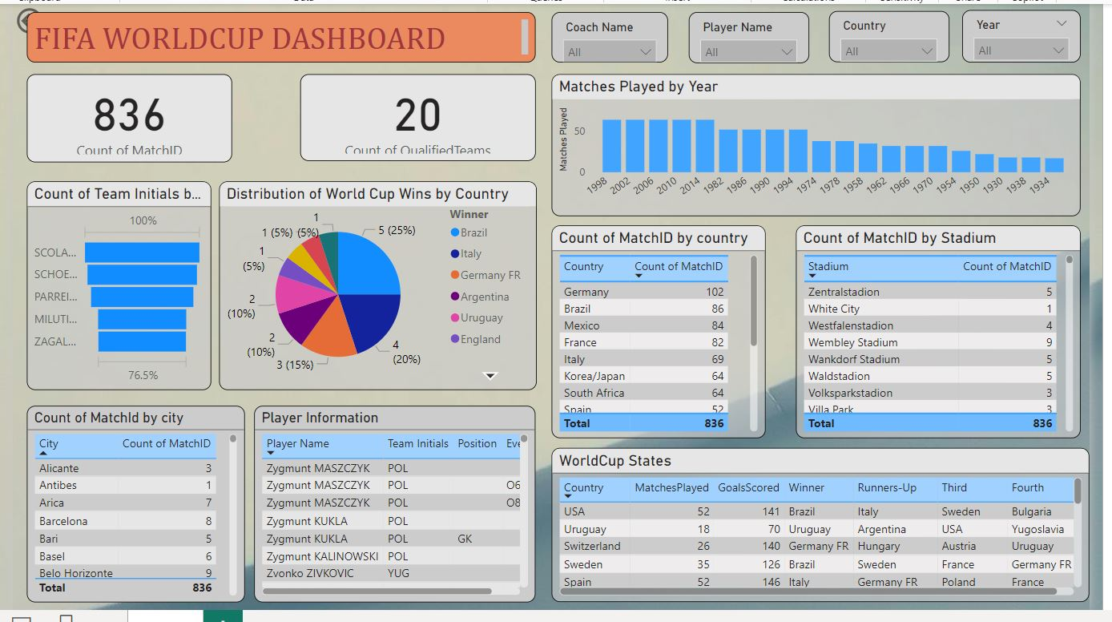
VISUALIZING DATA - DASHBOARD

Slide 6

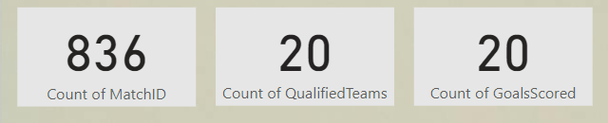
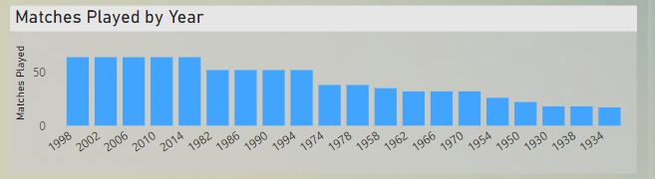
VISUALIZING DATA
Used slicers for filtering by Coach name, player name, Country and City.
Use a card visualization to display the count of matches, count of qualified teams and total number of goals scored across all World Cups.
Used stacked column chart to display all the matches played by year.

Slide 7
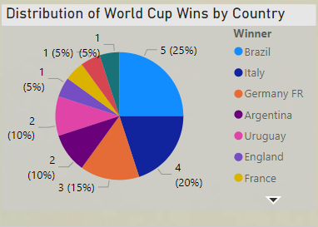
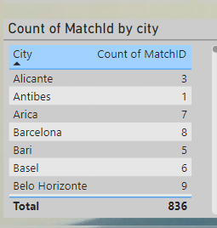
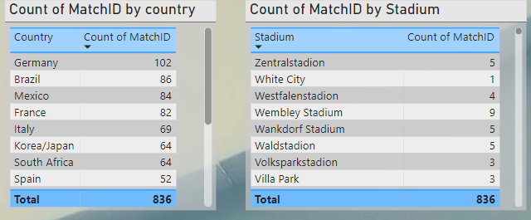
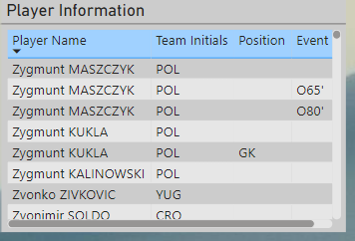
VISUALIZING DATA
The pie chart will display the distribution of World Cup victories by country, with each segment representing a country and the size of each segment indicating the number of times that country has won the World Cup.
Tables are created to show count of matchID with respective to city, country and stadium.
One more table is used here to display all the information of players.

Slide 8
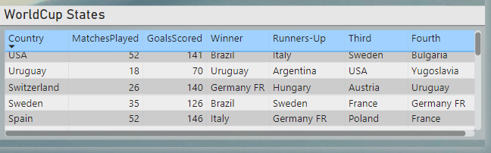
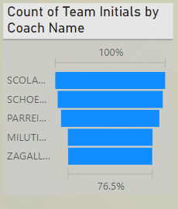
VISUALIZING DATA
Used table to display player information, including the team, position, and events, with interactive slicers to filter the data by Coach Name, Position, and Year.
The "count of team initials by coach name" tells you how many times a coach has managed different teams or how many times they have managed the same team across different tournaments. For this purpose funnel is used here and display top 5 among them.

Slide 9
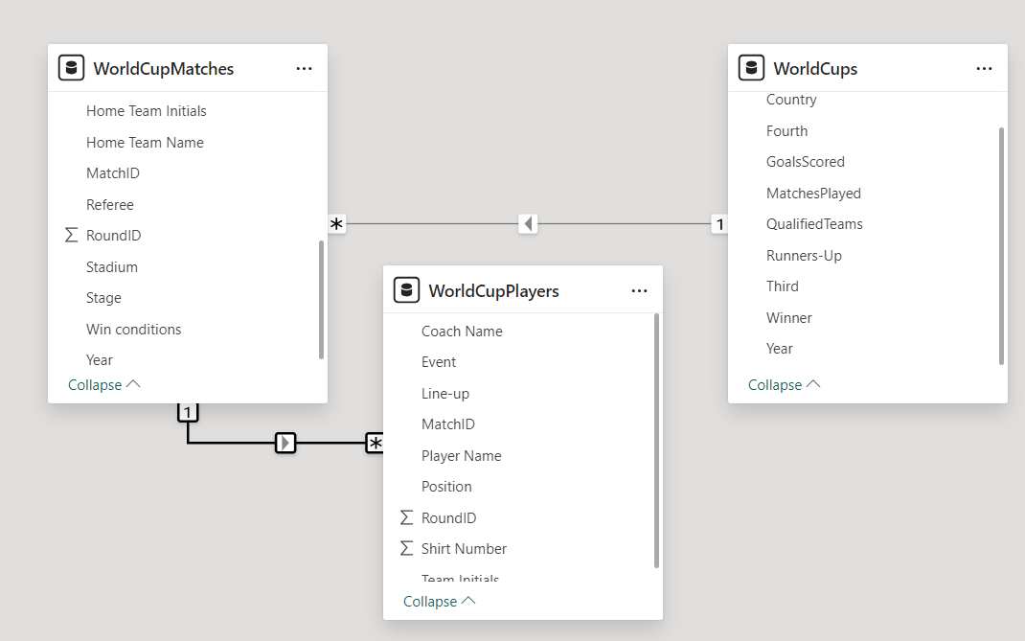
Relationship between tables

Slide 10
INSIGHTS AND DATA ANALYSIS
Germany has hosted or been associated with 102 matches in the given time frame (across different tournaments).
Brazil follows with 86 matches, and so on for the other countries listed.
The Total count of 836 matches corresponds to the total number of World Cup matches played across these tournaments.
Each stadium listed hosted a certain number of matches during various World Cup tournaments.
The Count of Match IDs represents the number of World Cup matches held at each stadium.

Slide 11
INSIGHTS AND DATA ANALYSIS
Germany recorded the highest attendance among all countries.
Brazil has won the World Cup 5 times, making up 25% of all wins. Italy has won 4 times, which accounts for 20% of the total. Germany (including West Germany) has won 3 times, contributing 15%.Argentina, Uruguay, and France each have 2 wins, each accounting for 10%.England has won once, making up 5% of the total wins.
836 matches have been played across all World Cup tournaments.20 teams were qualified. And total number of goals scored is 20.
The table lists players from various teams and positions, giving insights into the impact individual players have had, especially those who contributed to important events.

Slide 12
INSIGHTS AND DATA ANALYSIS
Olympiastadion hosted most World Cup matches across the tournaments i.e. 14.
Host nation advantage: It is possible that the data shows attendance is higher in countries that host the World Cup, but this cannot be confirmed from this image alone.
Most experienced coaches by teams coached: SCOLARI Luiz Felipie(BRA) coached the most teams throughout his career followed by him is Schoen Helmut(FRG).
Germany has hosted or been involved in the most matches (102), reflecting its consistent performance in reaching the latter stages of multiple tournaments.

Slide 13
CONCLUSION
This Power BI dashboard offers a detailed analysis of FIFA World Cup results, allowing users to derive meaningful insights from historical match data. Through the use of data mining techniques and impactful visualizations, the dashboard enhances the understanding of tournament dynamics and trends over the years.
By examining key metrics such as match count, goals scored, and the distribution of World Cup victories by country, users can identify patterns and correlations that have shaped the history of the tournament.
The dashboard also highlights the influence of factors like coaching, venue, and team performance, providing a comprehensive tool for both football enthusiasts and analysts to explore the rich legacy of the World Cup.
This analysis not only celebrates past achievements but also serves as a valuable resource for predicting future outcomes and understanding the evolving nature of international football competition.

Slide 14
THANK YOU
By Prachi Khartade

